Slide 1
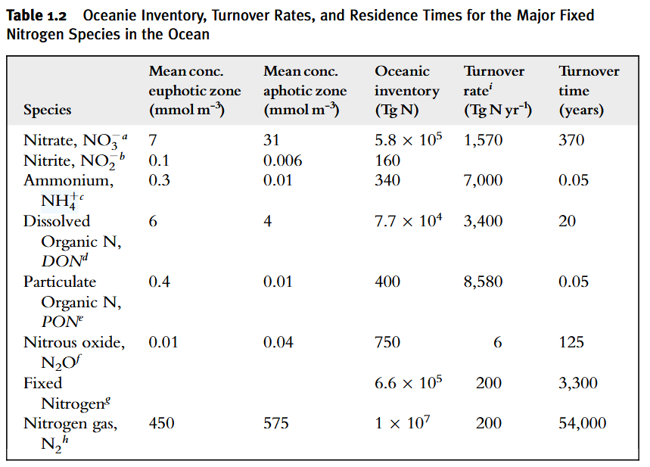
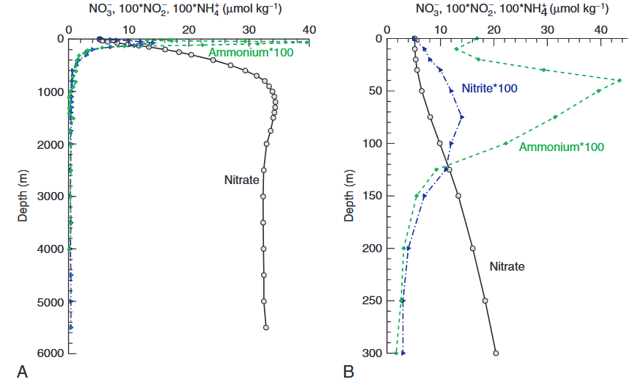

Slide 2
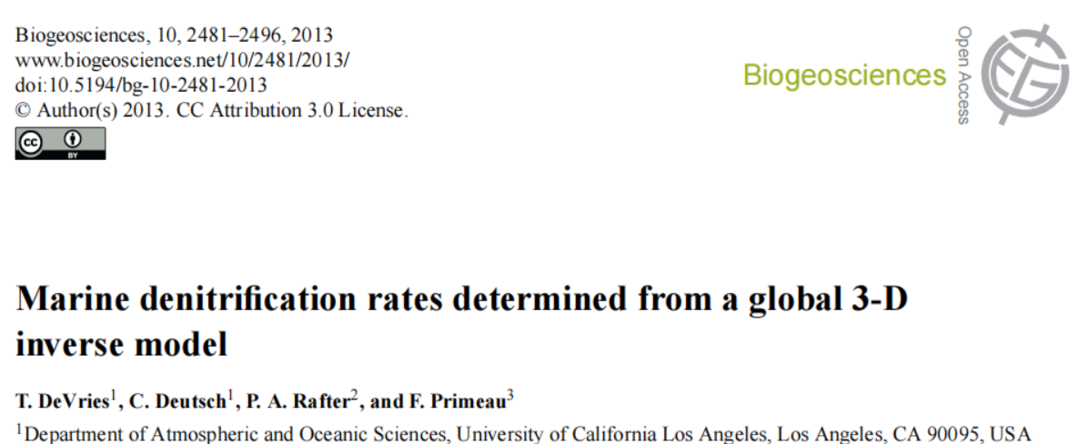

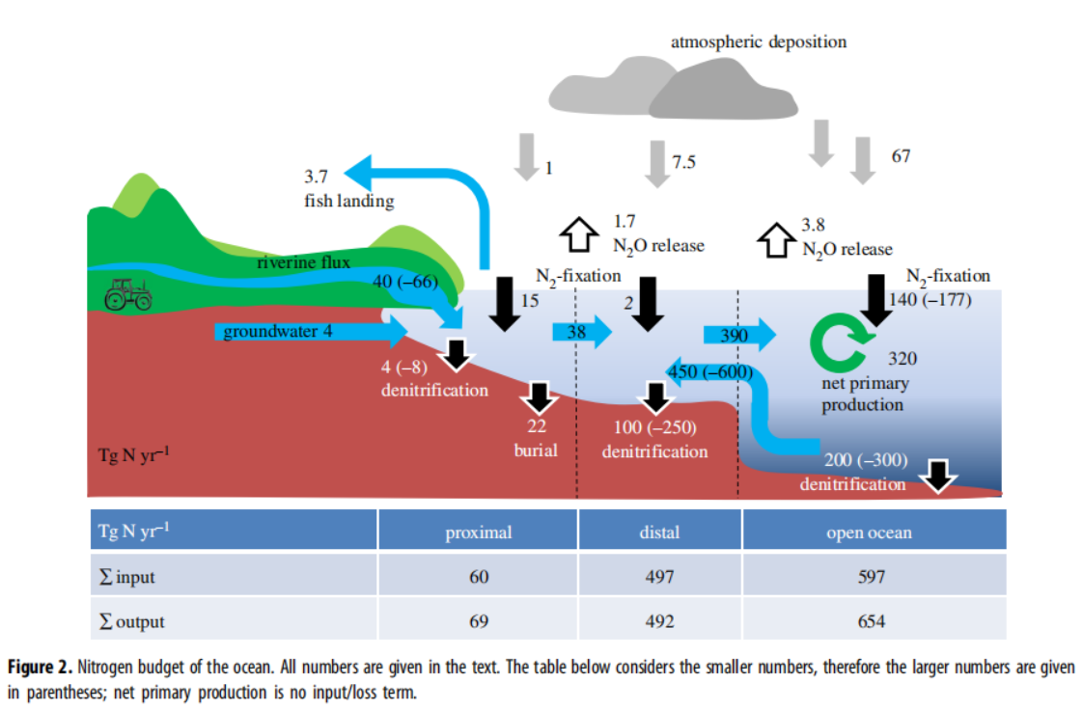
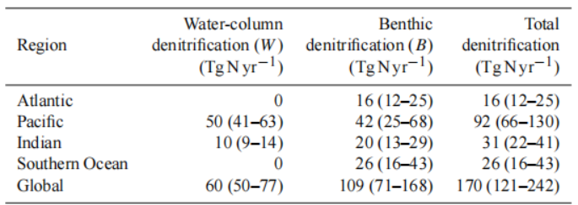

NH4_Nfix_P =15 Tg N/yr / 14= 1.07e12 mol N/yr
NH4_Nfix_D =2 Tg N/yr / 14= 0.14e12 mol N/yr
NH4_Nfix_S = 140 Tg N/yr / 14 = 10e12 mol N/yr
NO3_denit_P = 4 Tg N/yr / 14= 0.29e12 mol N/yr
NO3_denit_D = 100 Tg N/yr / 14= 7.2e12 mol N/yr
NO3_denit_S = 60 Tg N/yr / 14= 4.28e12 mol N/yr
NO3_denit_DP = 110 Tg N/yr / 14= 7.85e12 mol N/yr
In COPSE model

